Slide 1
How Visual Design makes for Great UX
Virtual design aims to improve a design’s aesthetic appeal and usability with suitable images , typography, space, layout and color. Virtual design is about more than aesthetics. Designers place elements carefully to create interfaces that optimize user experience and drive conversion.
Elements
Principles
Lines
Shapes
Negative space/whitespace
Volume
Value
Color
Texture
Unity
Gestalt
Hierarchy
Balance
Contrast
Scale
Dominance

Slide 2
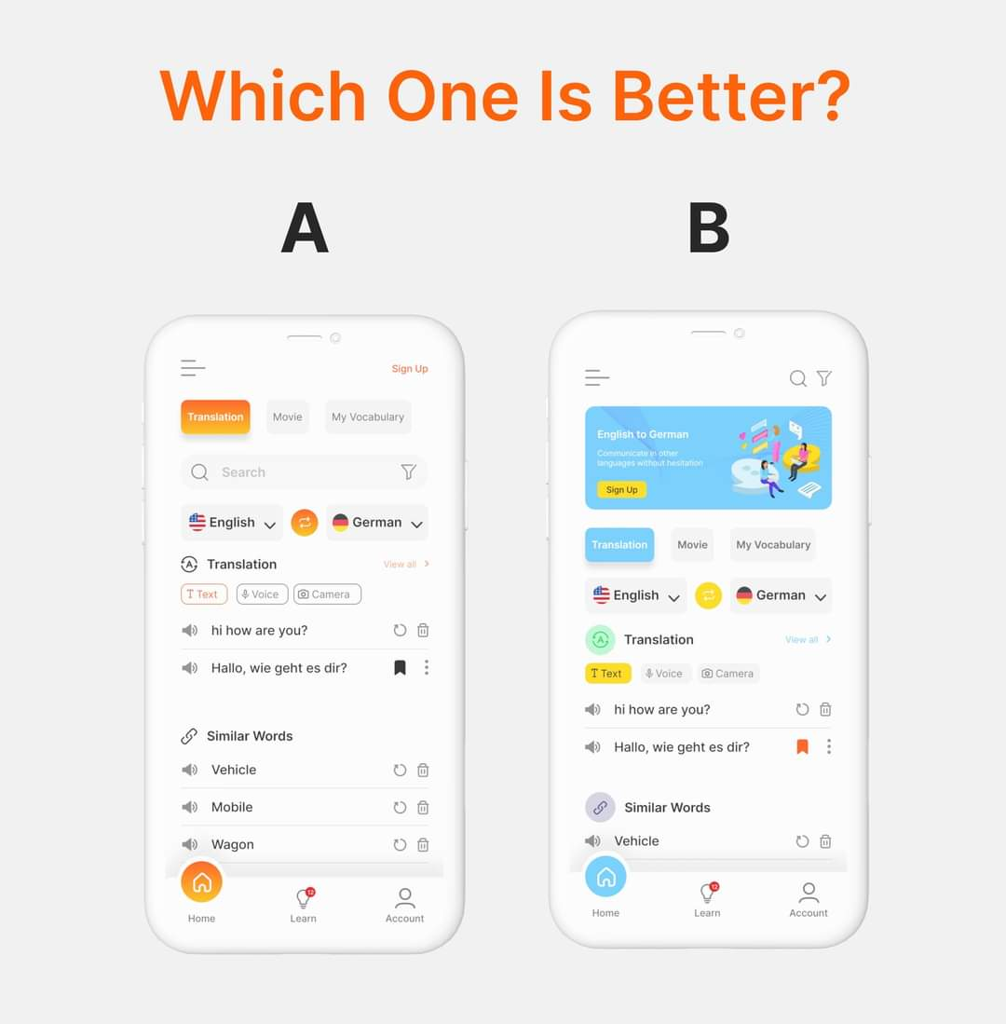

Slide 3
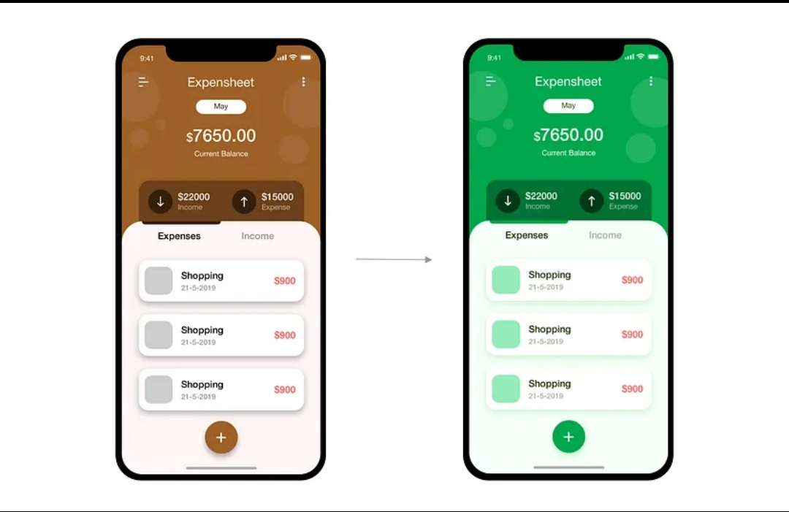
Why Color Must Be Used Properly in Your Website UI
Color can speak in ways that are every bit as powerful as language. They can reflect the personality of your brand. They can attract users, and they can better communicate your message. Any UI Design guidelines are likely to mention colors prominently.

Slide 4
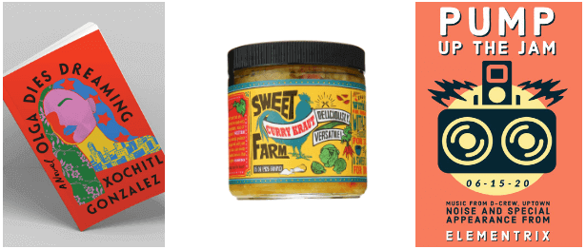
What is graphic design ?
Graphic design is the art and skill of visual communication. It’s the arrangement of visual content to convey a certain message to a particular target audience.

Slide 5
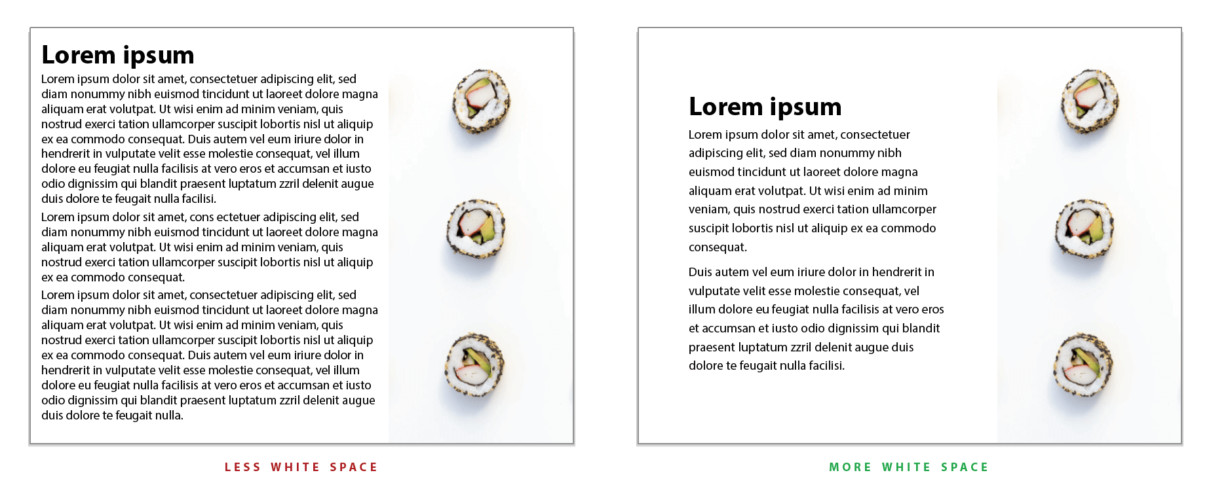
Why is typography in web or mobile UI design?
In web and mobile UI design, typography is the art of organizing typefaces on the interfaces to make all copy readable, legible and scalable to the audience. Visually appealing typography sometimes even catches the user’s attention and increases the interface conversation rate effectively.

Slide 6
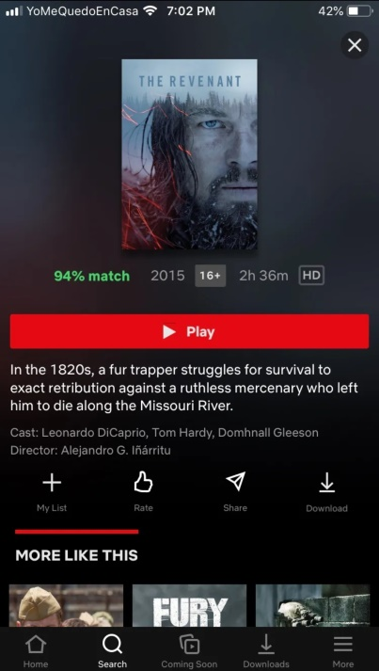
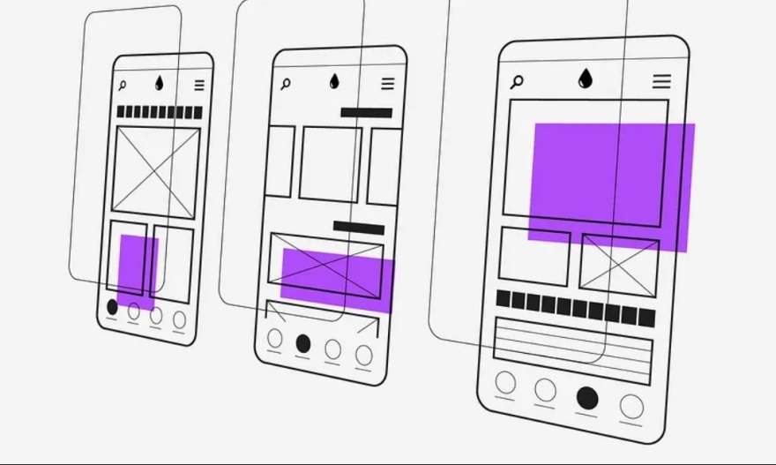
What is Layout?
The Layout is the structure that supports the visual components of an interface. It works opening the paths where the sight can shift to group , rank and make sense of the information. It also helps the content to highlight what is the most important data on the site. The layout function , thus , is invisible to the user but relevant to navigation.

Slide 7
